Slide 1
Fostering SRHR – HIV partnerships through a youth centred approach
Jael van der Heijden

Slide 2
“ AS a social franchise we enable organizations to work with our empowerment model to achieve locally driven impact for young people’s sRHR, incl. HIV/AIDS”
Notes:
Good morning everyone, it is a pleasure to be here today in this panel of experts. It is great to see that everyone in this panel has a different and unique expertise. Let me quickly introduce Dance4lIfe before I get to the theme of todays panel.
Dance4life is a social franchise that empowers young people to take personal leadership in their sexual lives. We use youth culture music and dance to create dynamic dialogue spaces and engage youth through experiential learning.
We believe in co –creating youth empowerment together with local partners and young people, putting them in the driver seat of sustainable change.
This means:
We are a social franchise and not a grant maker
We stimulate local ownership
We empower young people instead of educating them
We bring realities of young people to decision makers instead of doing advocacy for them
We co-create with young people and local partners instead of just consult them
Today I want to make a plea for a more human centred design approach, and how this can help to foster collaboration between HIV and SRHR movements. Because what does this actually mean, to take a human, or youth centred approach?

Slide 3
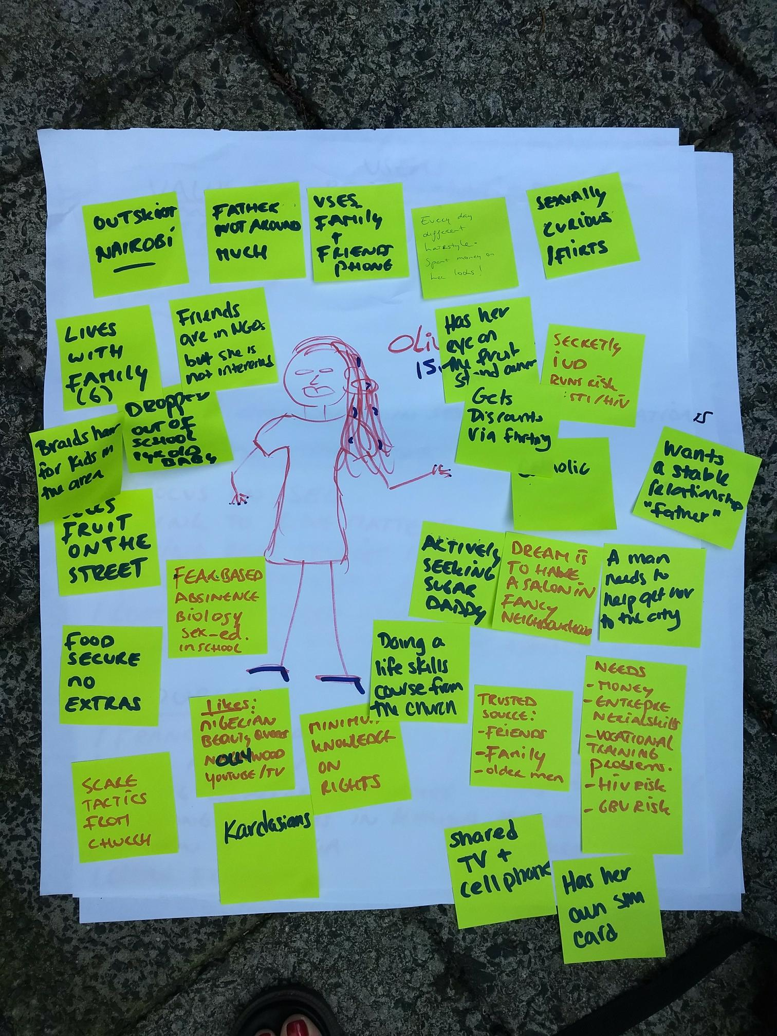
Olivia
Notes:
Well it means starting from the person. For example, here we have 16 year old Olivia from outskirts of Nairobi. And she has many things going on in her life. I won’t go into all, but:
Her dream is to start a beauty parlor, inspired by many of the Nigerian soaps she watches on You Tube. But she also dropped out of school when she got pregnant and she now lives with her family, including her 1 year old son. For a young person such Olivia words like SRHR or HIV and let alone funding streams are not so relevant. She is more thinking about how she can get some sponsors to earn money to make her dream a reality. So giving her a self injectable and tick the box of ‘uptake of service’ for our donors, will not necessarily bring her closer to her dream until she understands she is also running a high risk of HIV infection from her sponsors.
Unless we actually spent more time to understand Olivia and also empower her to reflect on her own ambitions and challenges in life, we are not really making sustainable change for her.
I think that everyone in this room here is committed to meaningful youth participation in order to end AIDS and ensure progressive SRHR for all young people. But it is not easy to make meaningful youth participation practical. We believe in taking a co-creative approach and meeting the young people where they are. Understanding the realities of young people and co-creating solutions with them is crucial if we really want to make sustainable changes. Not only in programming on the ground, but also in designing policies and making political agreements at national, regional and international level, including funding. That’s why it is so important to bring these realities of young people to international political spaces.

Slide 4
storytelling event “Speak up, Speak out: voices of young rural women and girls.” – CSW 2018
Notes:
Like we did in collaboration with Women Deliver and CHOICE for Youth and Sexuality as a part of the Right Here Right Now program at CSW earlier this year. We organised a storytelling event called “Speak up, Speak out: voices of young rural women and girls.” We worked with youth advocates from Kenya, Jamaica, Trinidad and Tobego, Honduras and the Netherlands to prepare and deliver their stories. And these were not just stories. We supported them to link these stories with specific advocacy objectives and trained them to run youth consultations in their own countries to base the stories on the actual realities of young people there.
This resulted in a storytelling evening that formed a safe space for a diversity of young people at a major UN event, with stories of love, misunderstanding parents, abortion, losing your virginity, of being HIV positive and pregnant. Demonstrating that when young people talk about their lives with their peers there is no distinction made between issues of HIV and SRHR.
What really added power to this evening is that the UN Youth Envoy, Ms. Jayathma Wickramanayake, and the Women Deliver CEO Katja Iversen also told stories of young women from rural areas in their country too, adding to this powerful moment of truly bringing realities from the ground to the high level.
So in the end what we hope for by bringing these realities to international spaces is that we do not have to wait for the future until these young people are decision makers. We hope the decisions makers of today will be inspired by them and start designing holistic programs and funding streams that are youth centred, instead of SRHR or HIV focused. And that can only be done by involving them, and not only consulting them. So we can really start co-creating sustainable change together.

